Slide 1
Course: Environmental Management (DJ19ILO8029)
Prepared By
Prof. Govind Wakure
DJSCE ( CSE ( Data Science Dept)

Slide 2
Course Objective & Outcomes
Course Objective:
Understand and identify environmental issues relevant to India and global concerns
Learn concepts of ecology
Familiarise environment related legislations
Understand Environmental Auditing Procedures.
Course Outcomes:
Identify Environmental issues and get familiarized to the concept of Ecosystem and environmental management.
Know policies and legal aspects and understand EM system standards.
Understand Environment Impact assessment.
Understand Environment Auditing procedures.
Describe Environmental management Techniques.

Slide 3
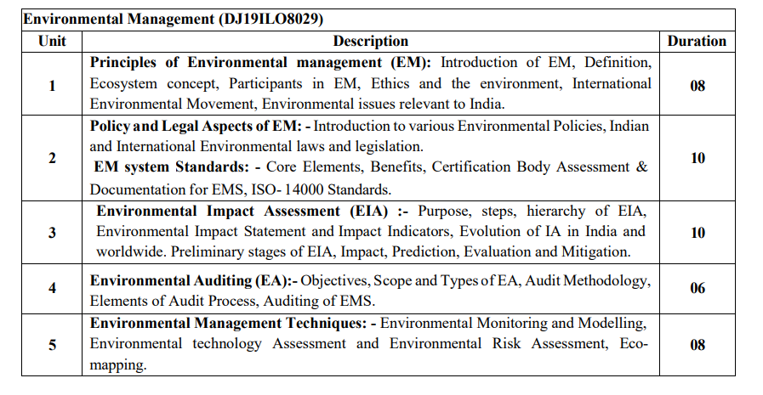
Syllabus of Environmental Management

Slide 4
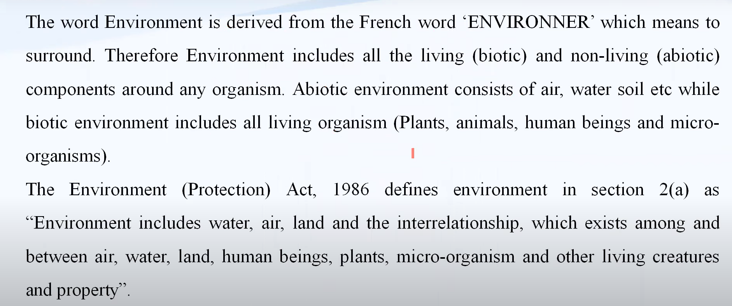
Environmental Management

Slide 5
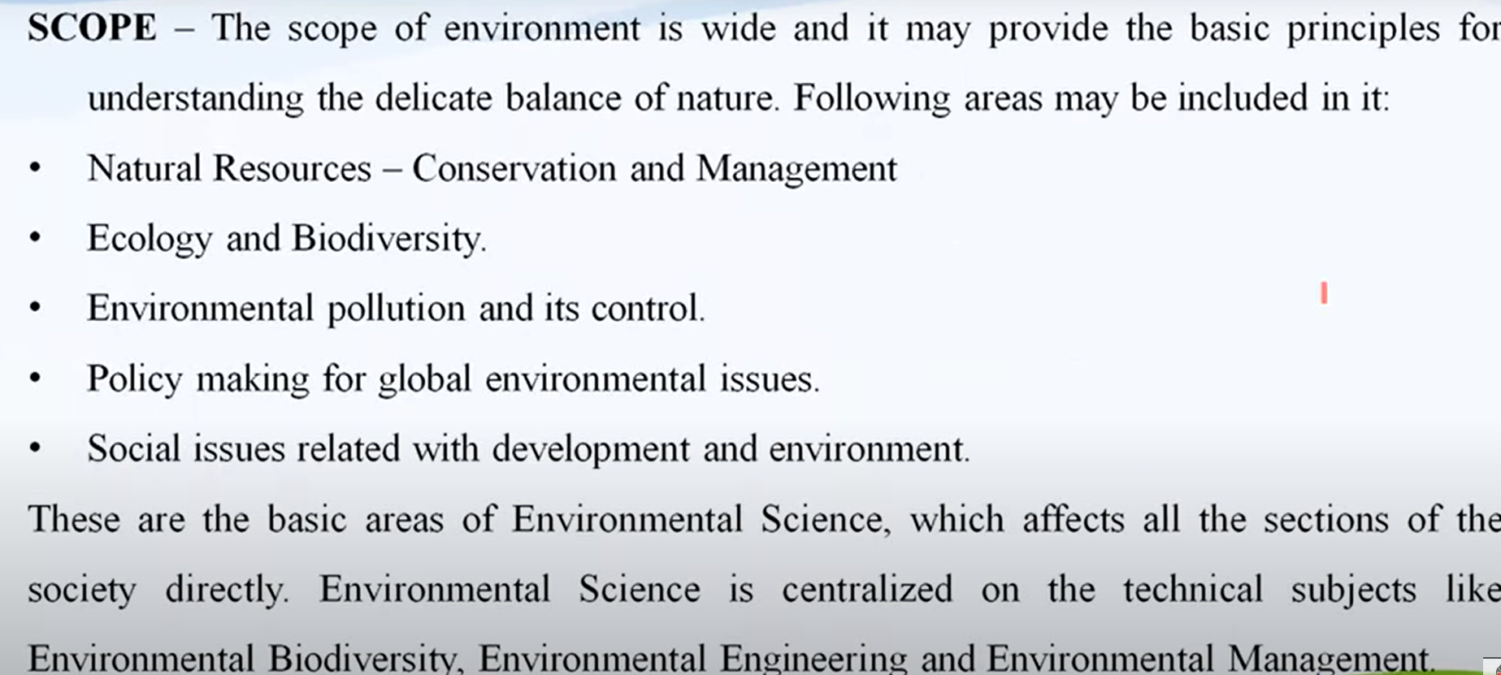
Scope Environment

Slide 6
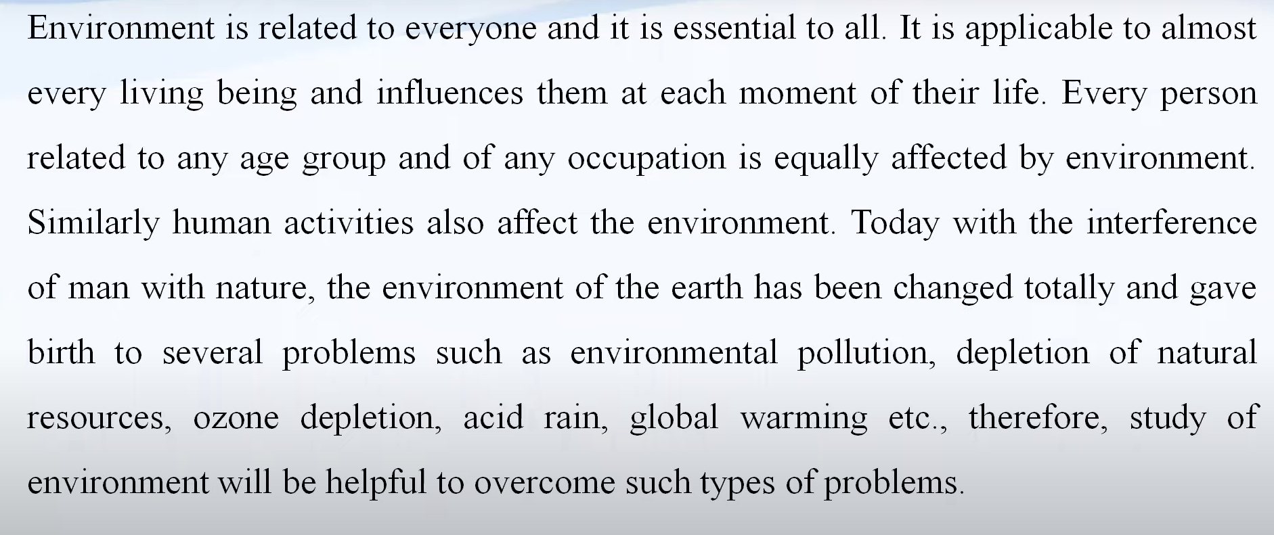
Scope Environment

Slide 7
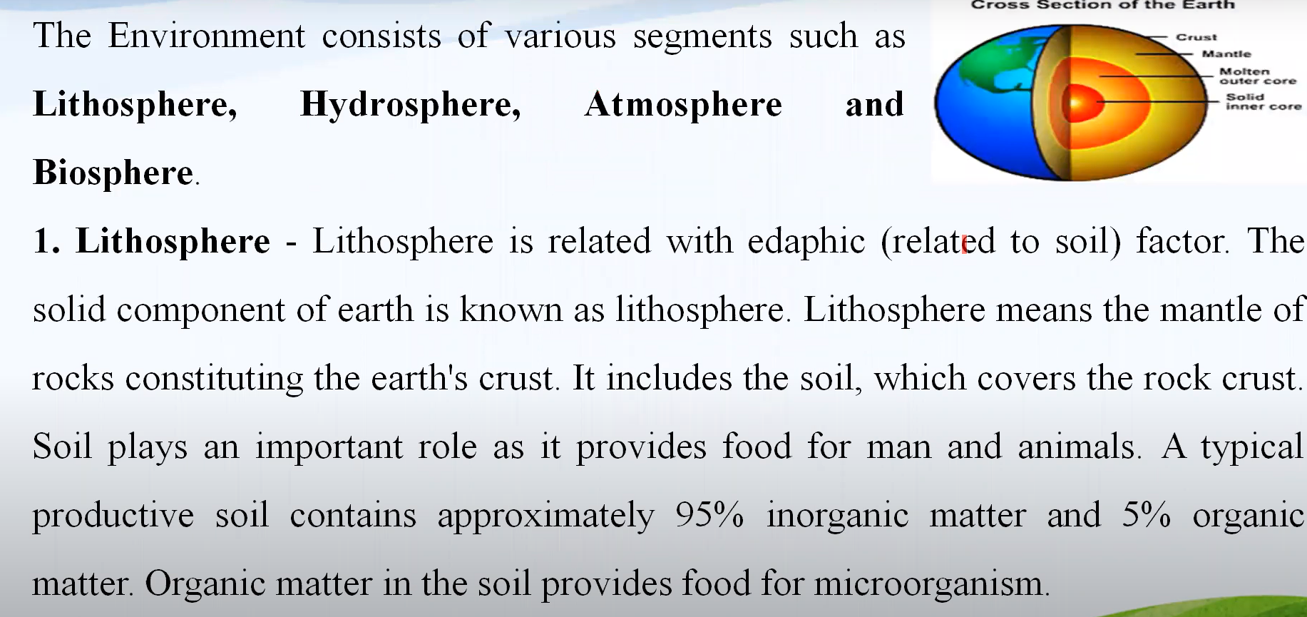
Segment of Environment

Slide 8
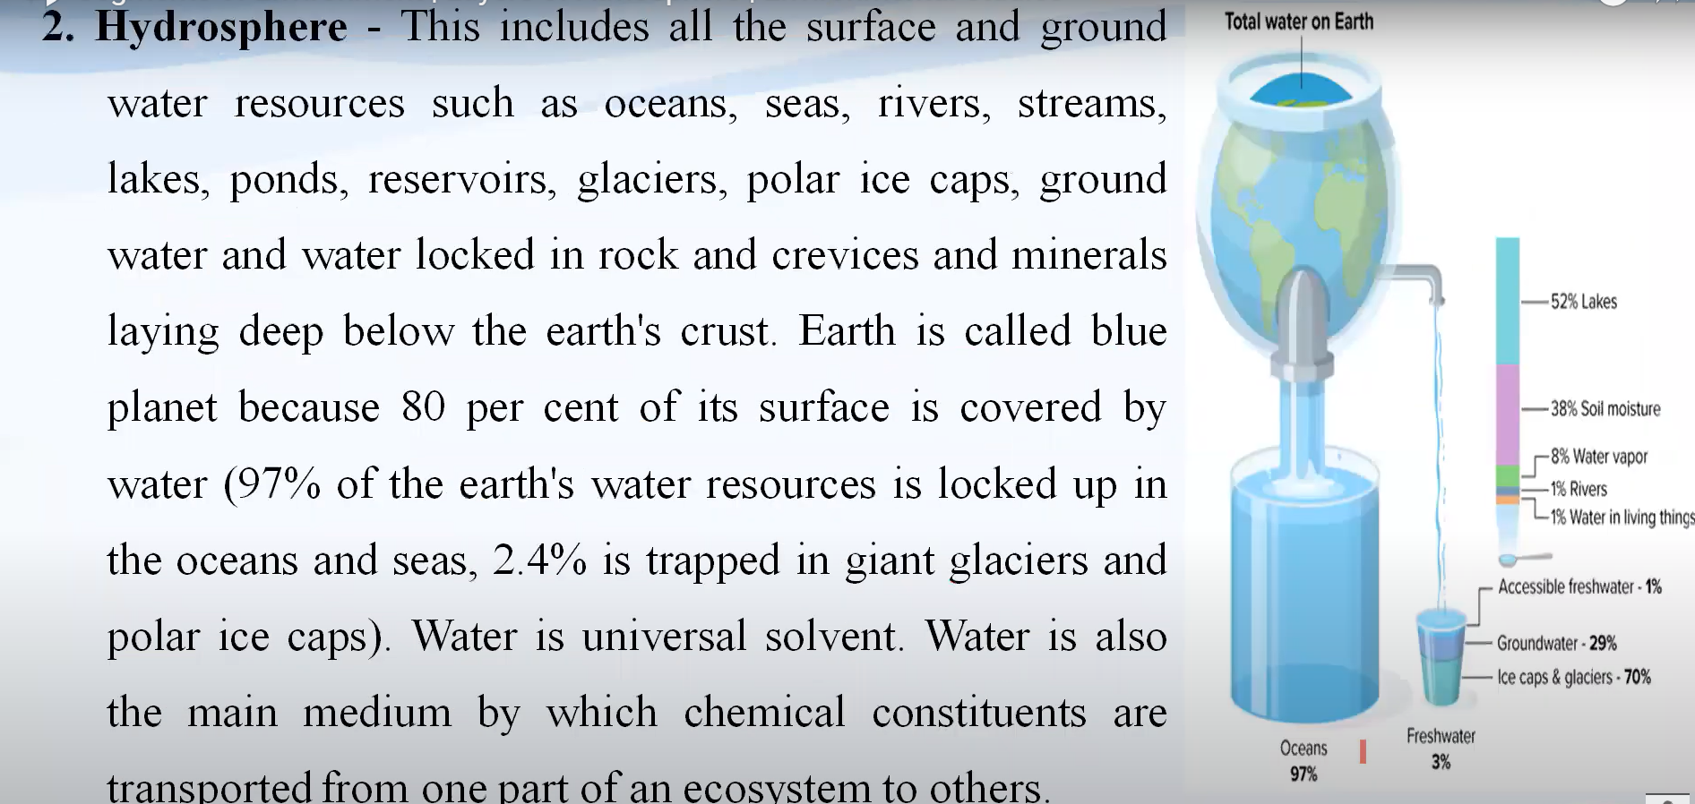

Slide 9
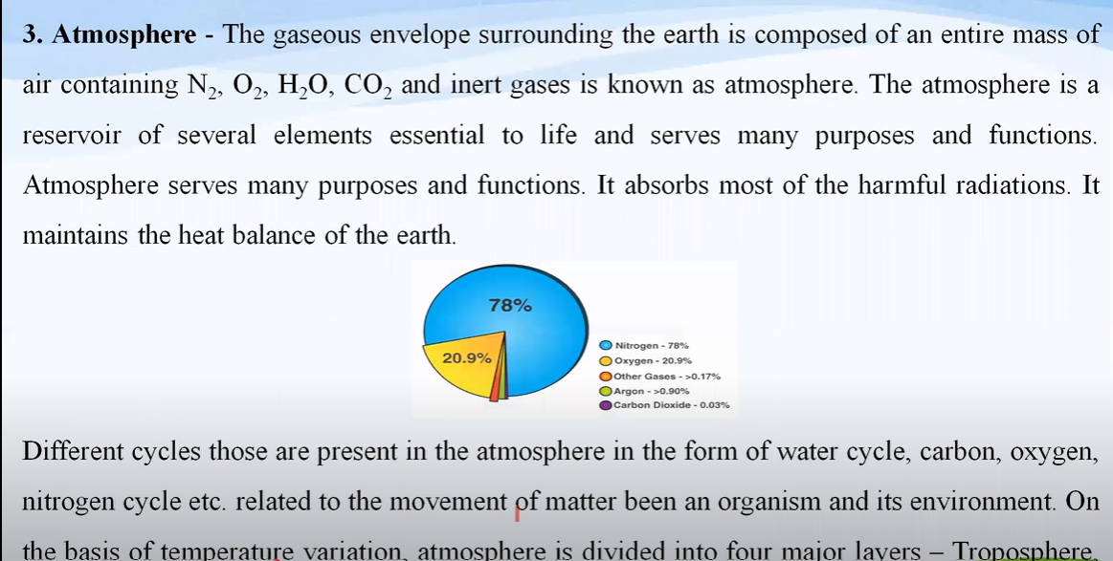
3. Atmosphere

Slide 10
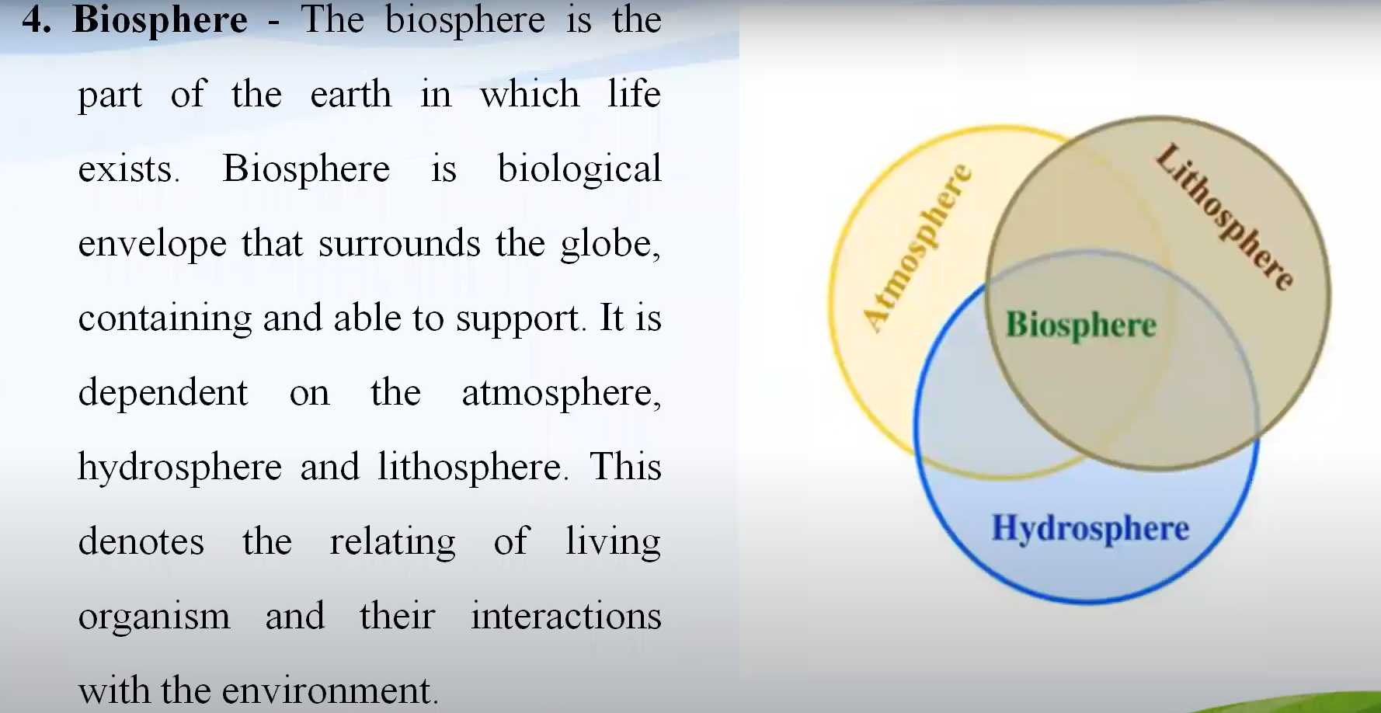
4. Biosphere

Slide 11
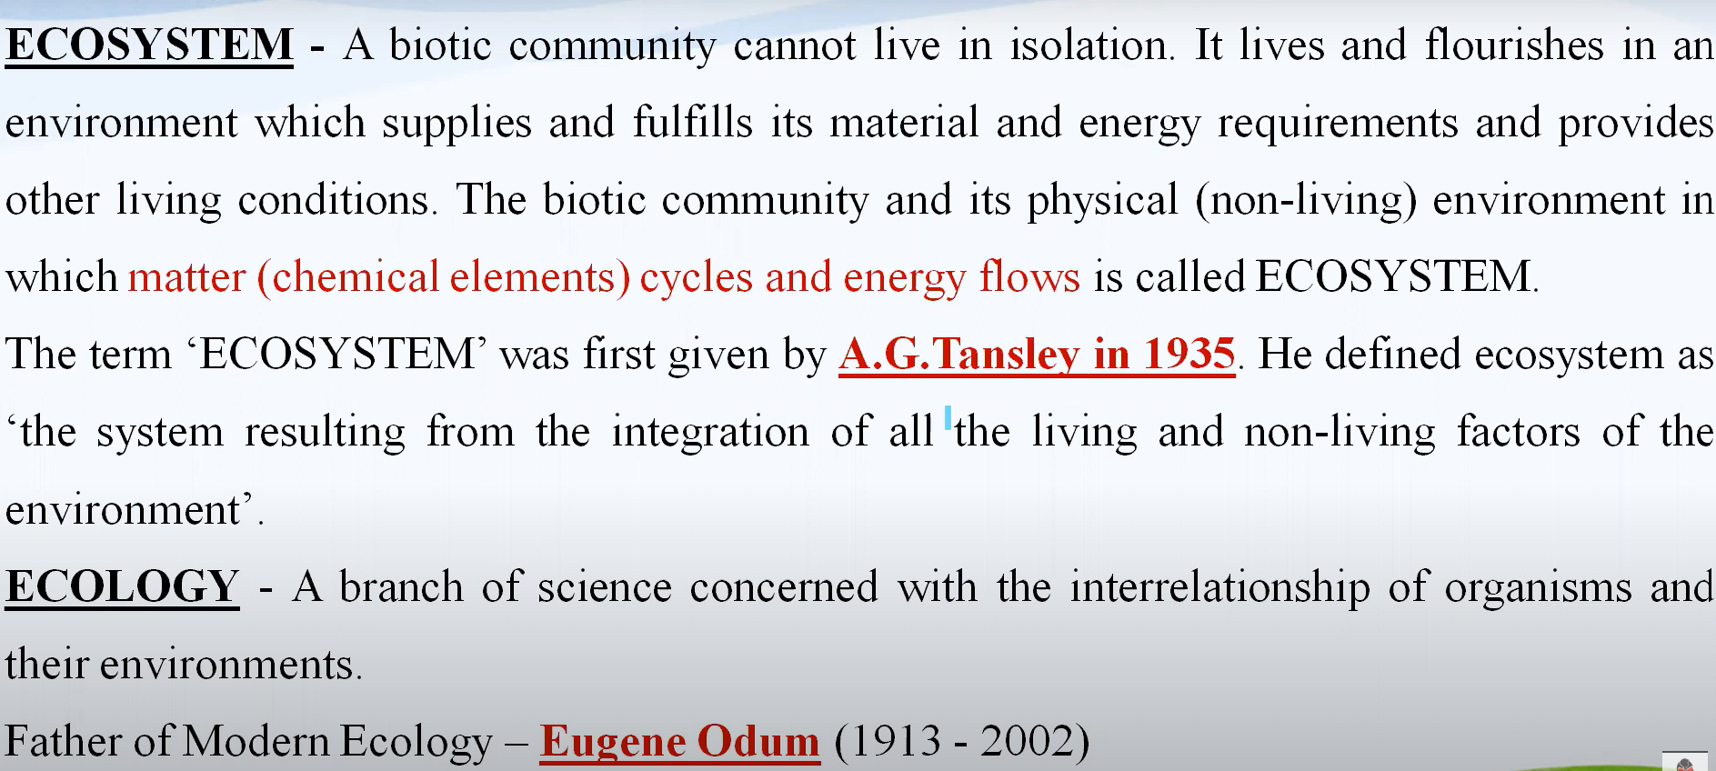
Ecosystem

Slide 12
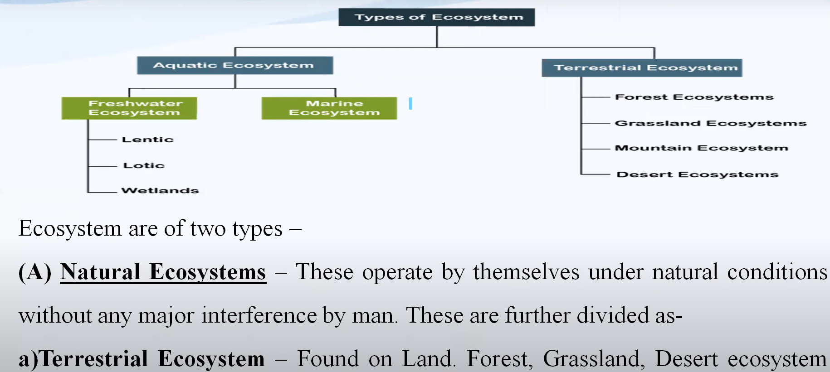
Types of Ecosystem

Slide 13
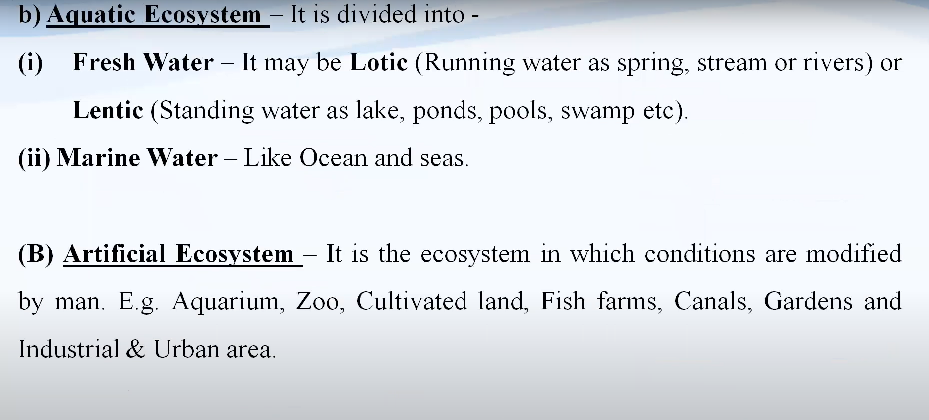

Slide 14
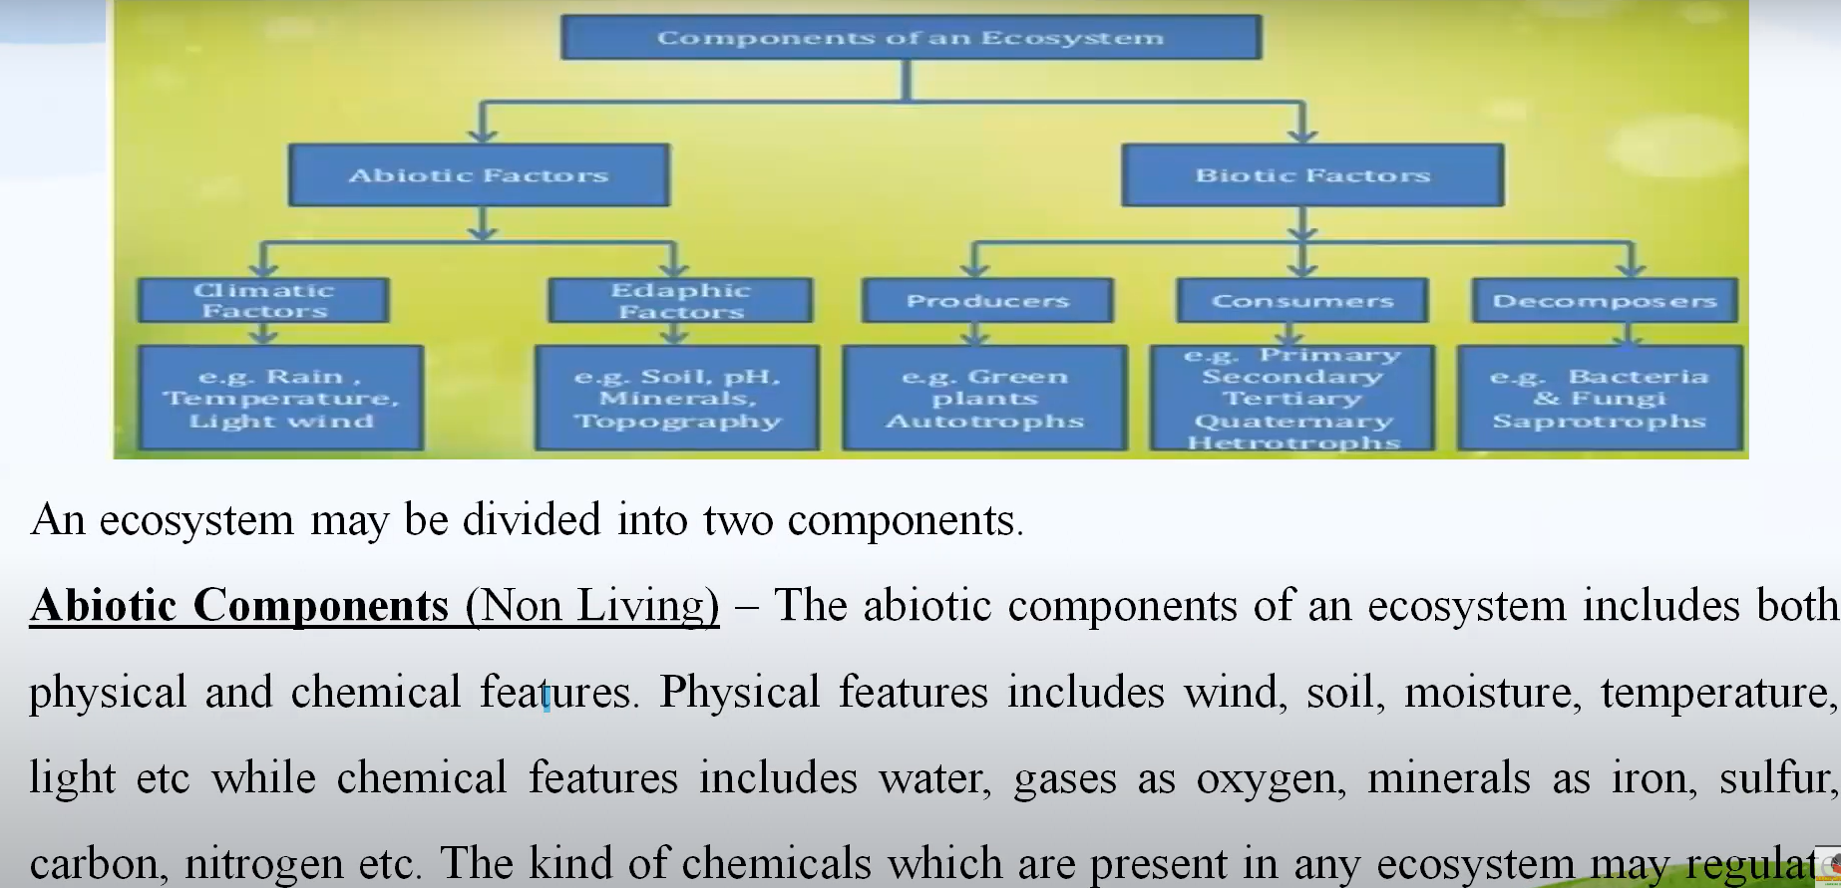
Components of Ecosystem

Slide 15
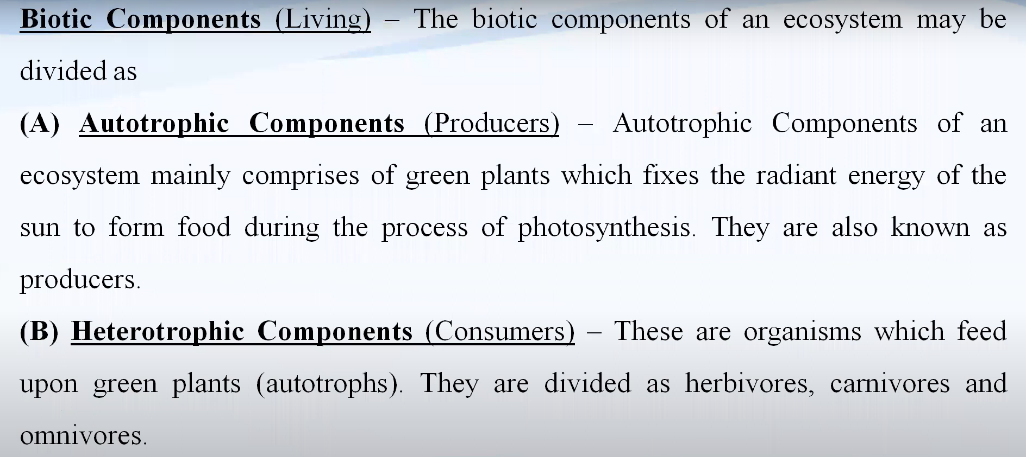

Slide 16
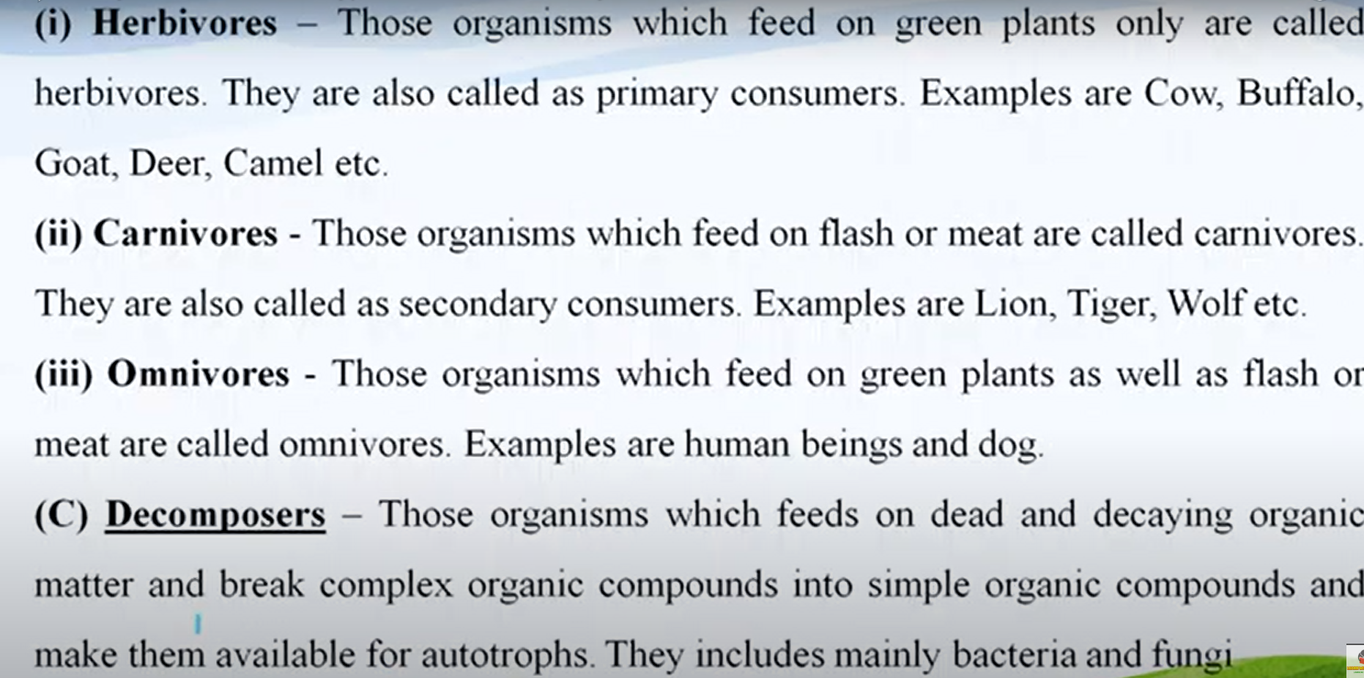

Slide 17
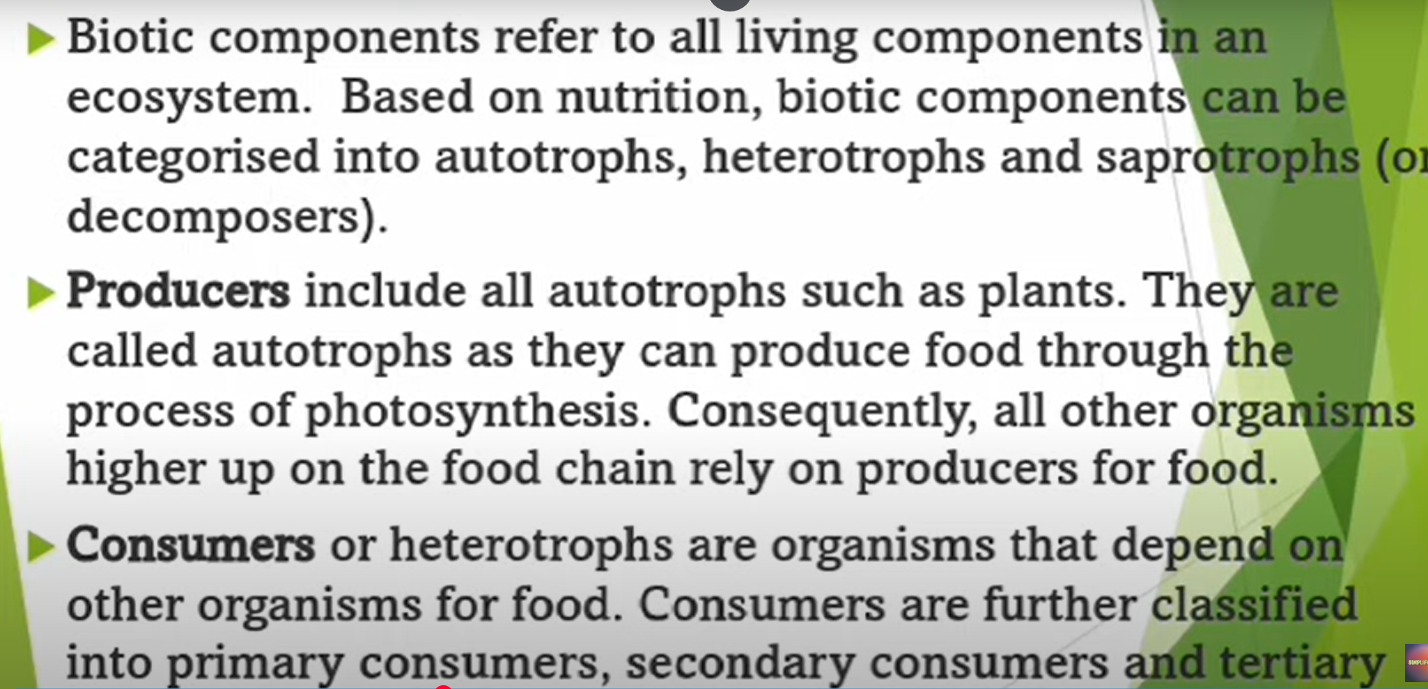
Example

Slide 18
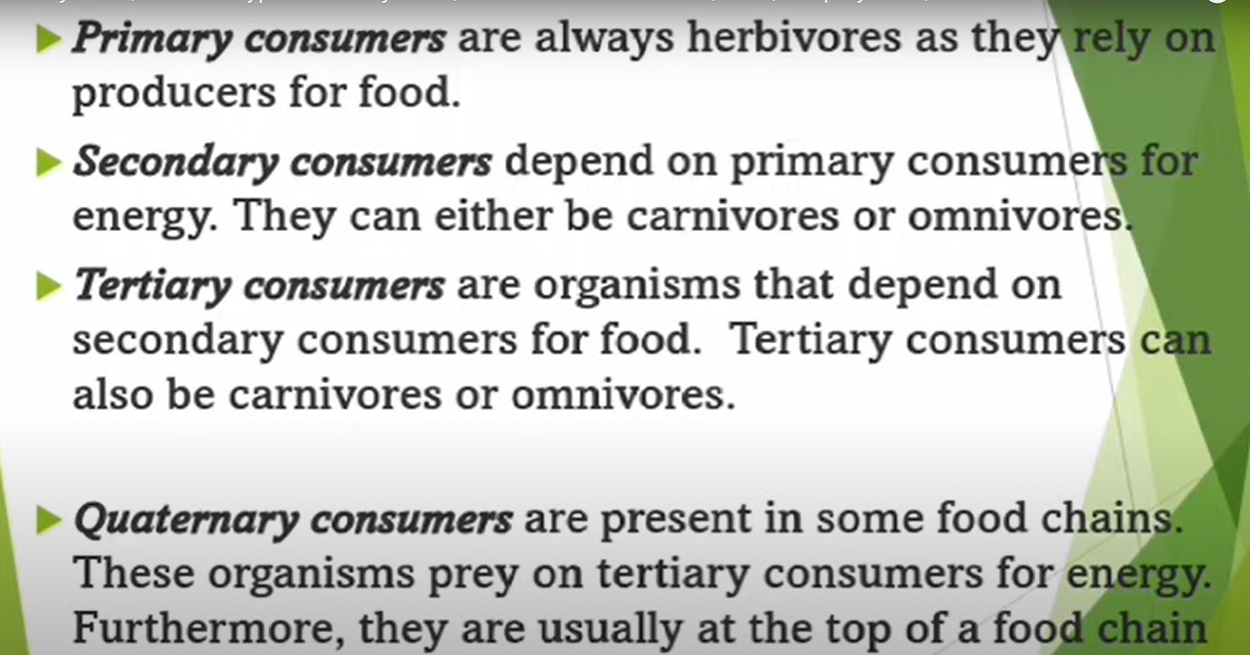

Slide 19
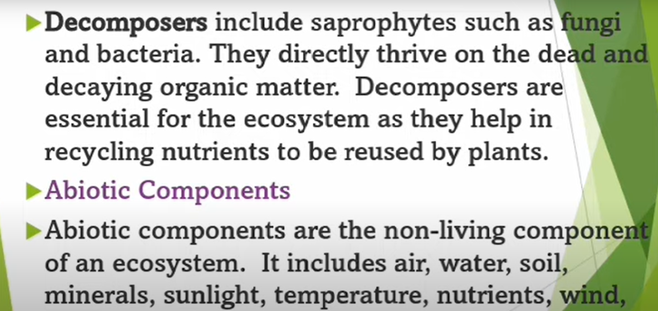

Slide 20
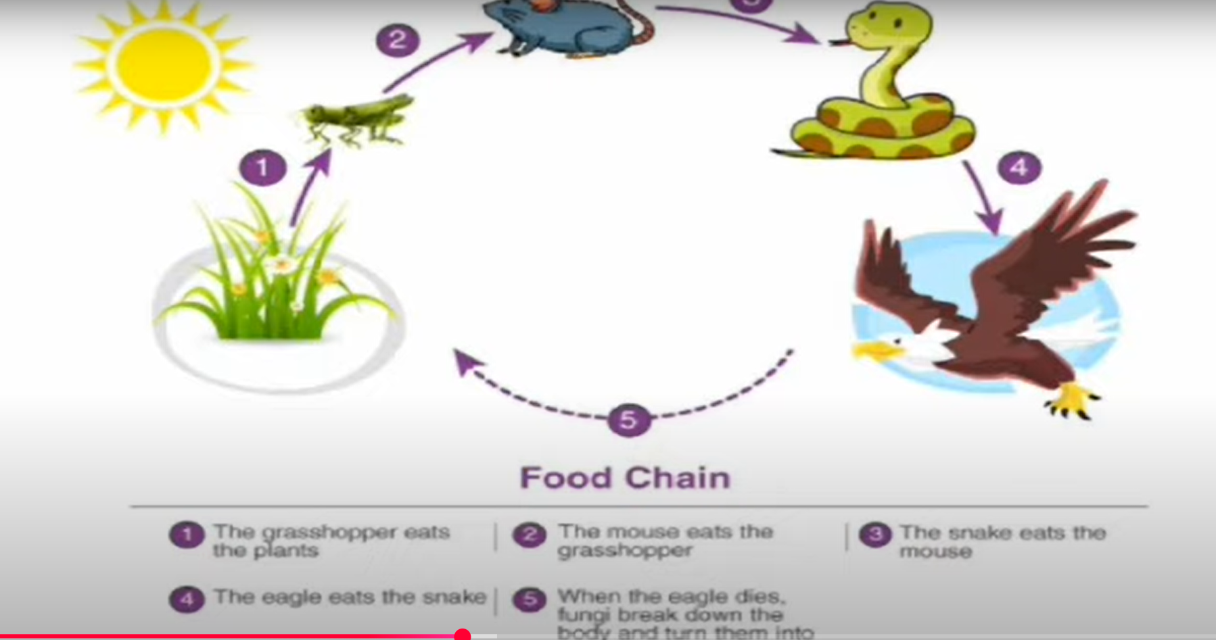
Example

Slide 21
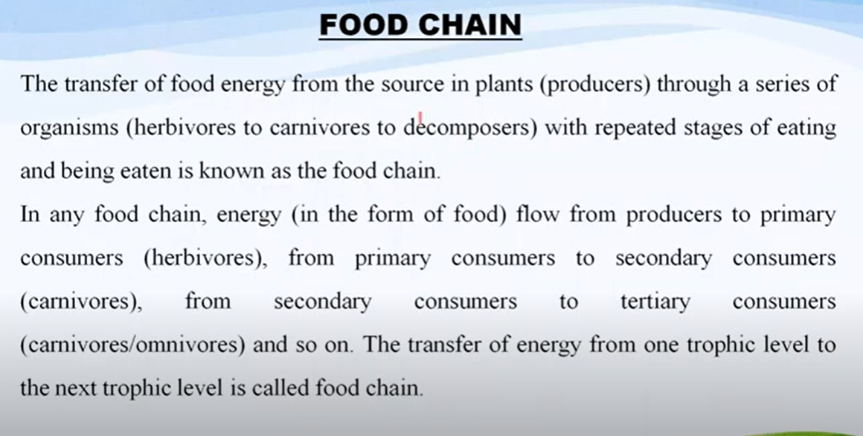

Slide 22
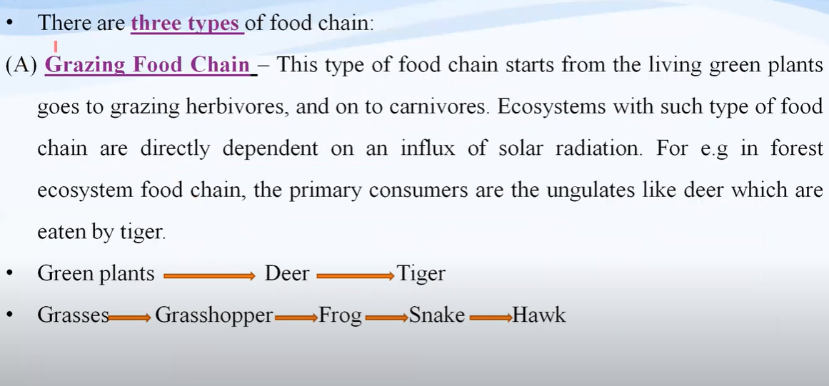

Slide 23
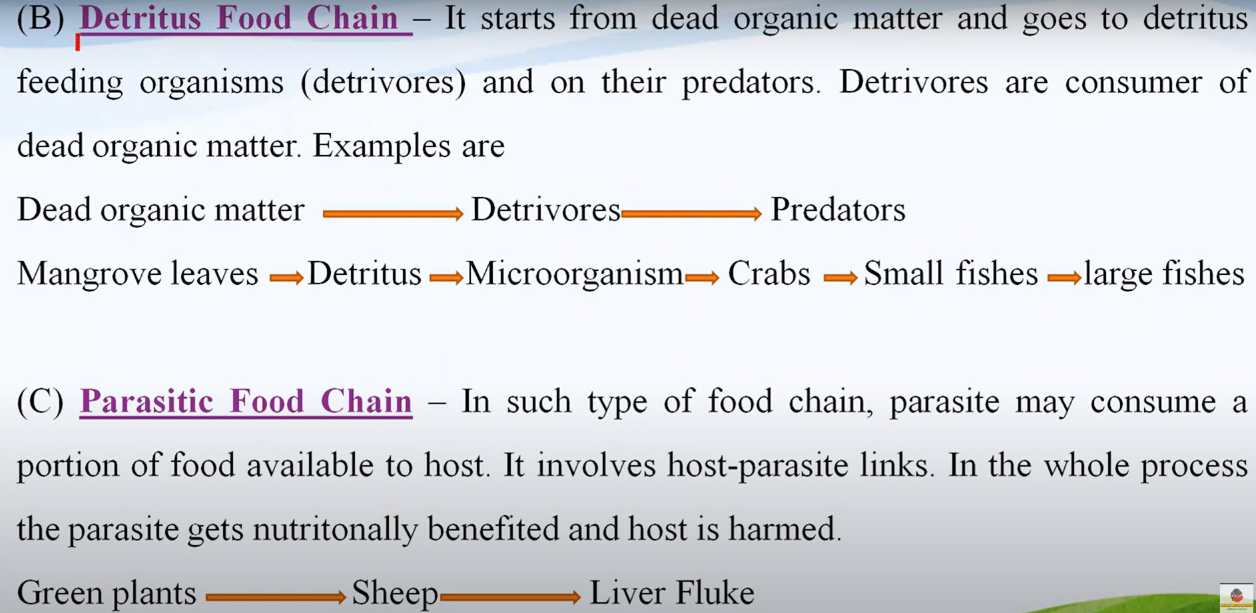

Slide 24
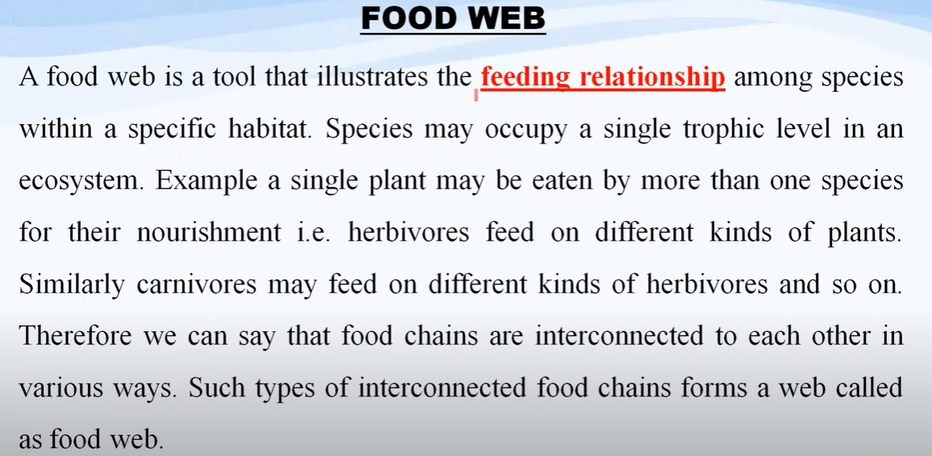

Slide 25
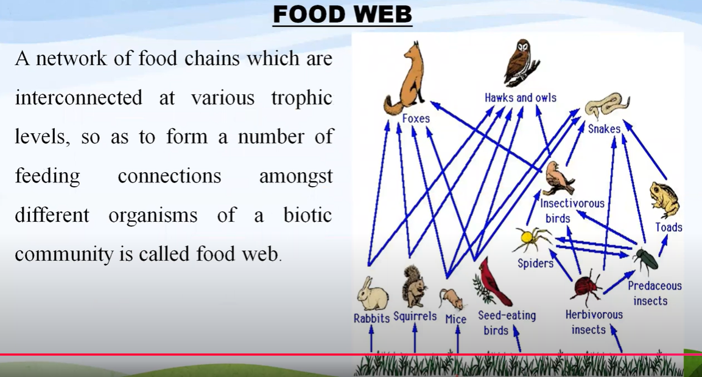

Slide 26
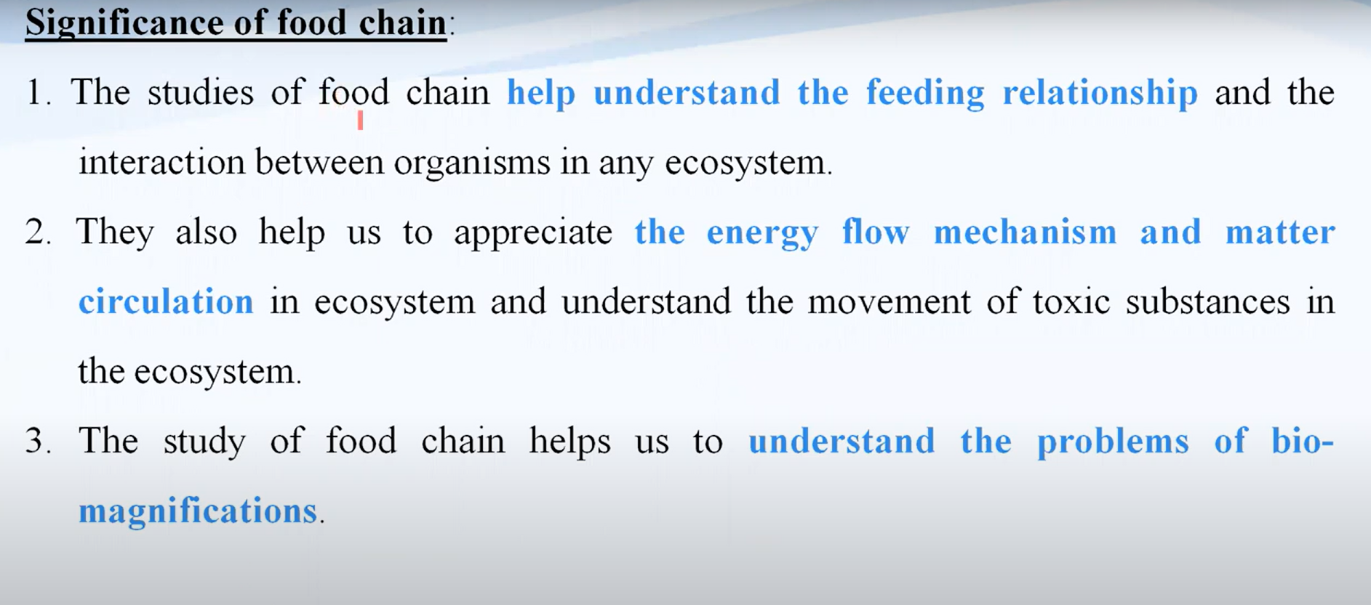

Slide 27
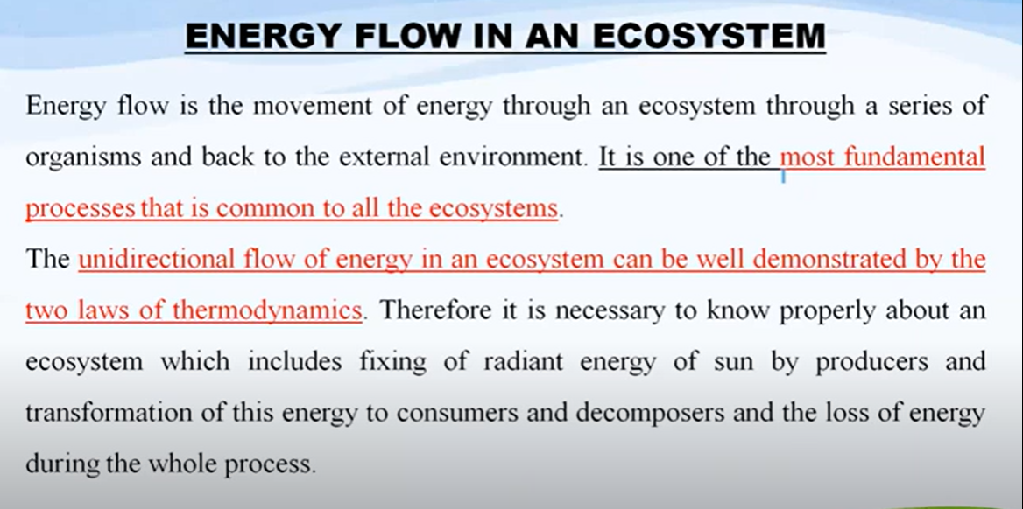

Slide 28
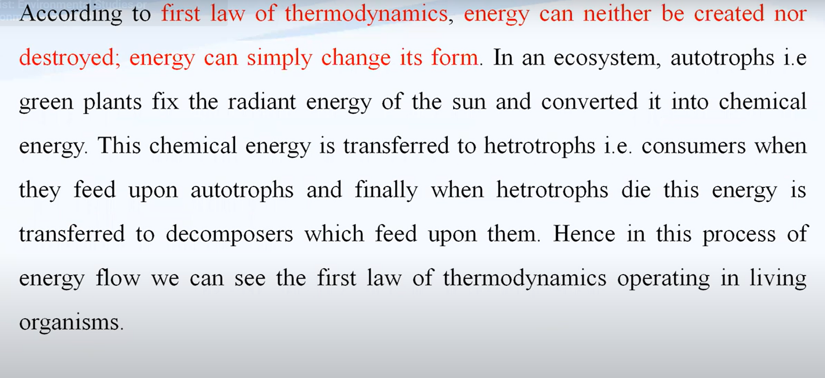

Slide 29
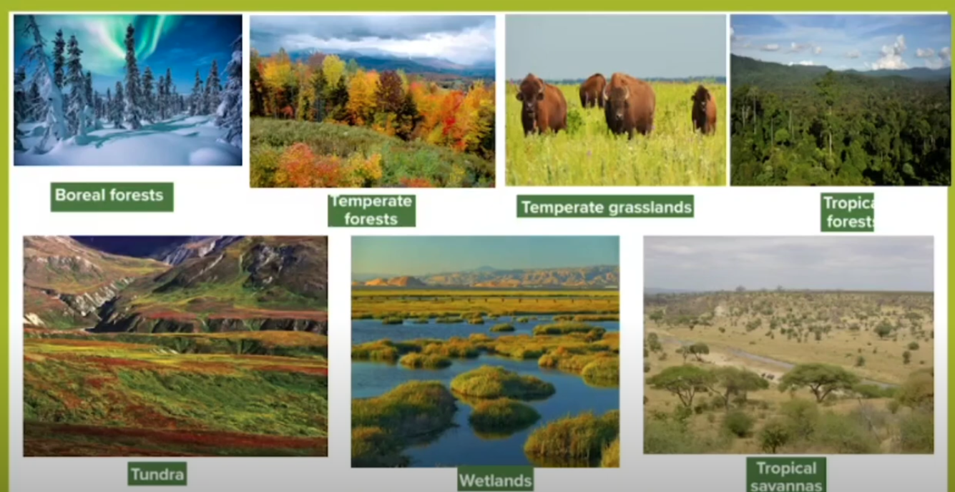

Slide 30
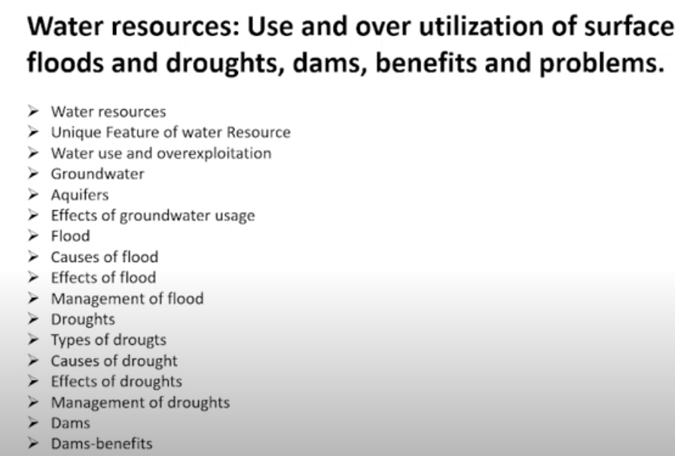
Natural Resources

Slide 31
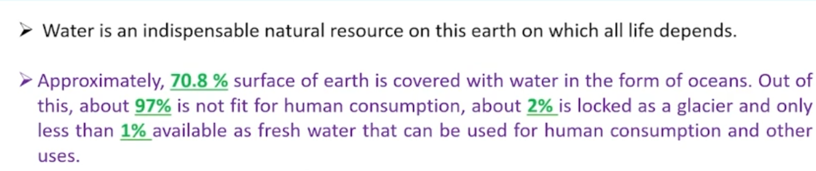
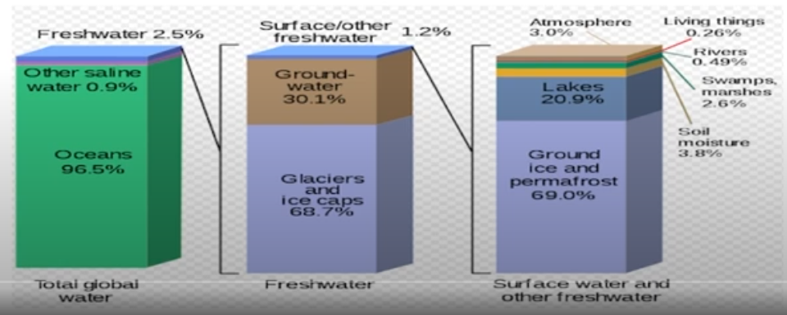

Slide 32
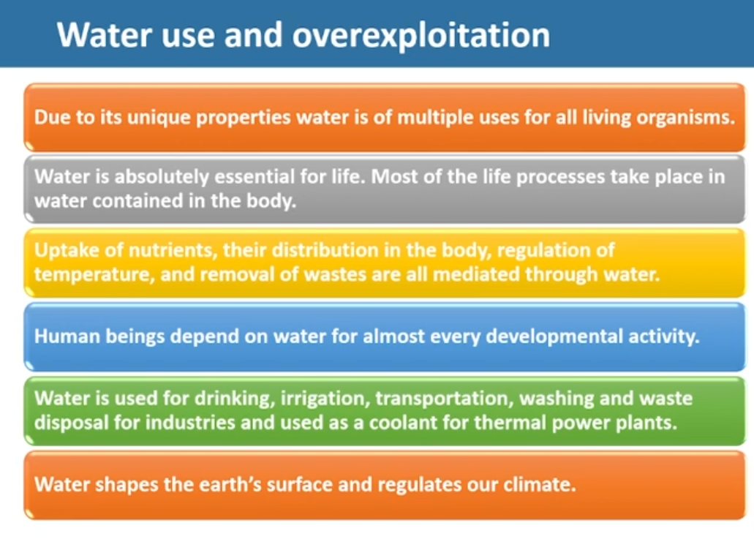

Slide 33
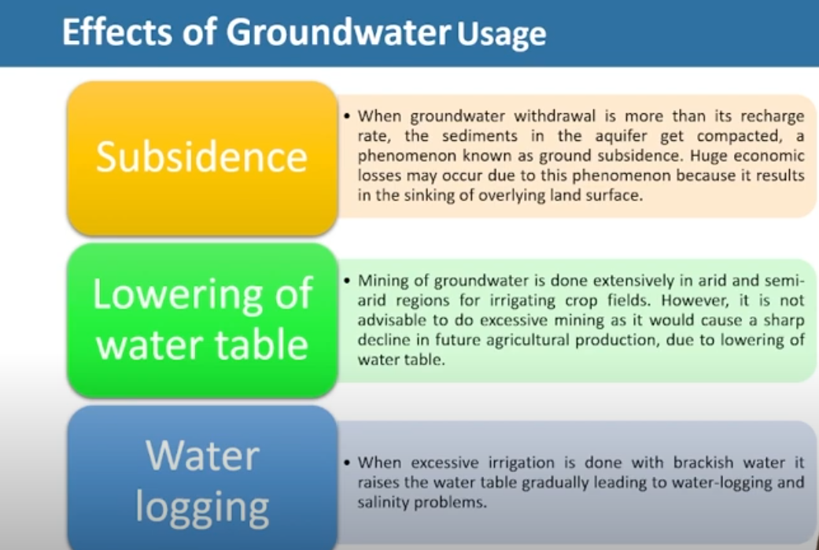

Slide 34
